Slide 1
Decentralised Ledger Architecture for Trustworthy Multi-Agent Memory
RM8502 – Assessment 2 – Exit Seminar
James Ross (14472266)
Advisor: Prof. Ickjai Lee (Head, Information Technology)

Slide 2
Agenda
Introduction:
  The Problem – Literature Gap
  Why Blockchain Technology?
  Research Aim & Core Question
Methodology:
  Study Design & Key Metrics
  Simulation Design
  Experimental Design
  Data Collection & Analysis
Results:
  Flawless Provenance
  Predictable Cost
  Core Performance Trade-off
Discussion
Conclusion

Slide 3
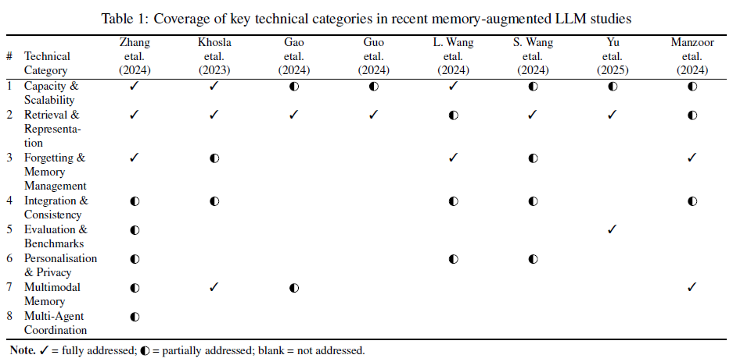
The Problem – Literature Gap
Literature Review - Memory Mechanisms for Large Language Model-Based Agents.
Single-agent memory advanced; Significant gap in Multi-Agent coordination.

Slide 4
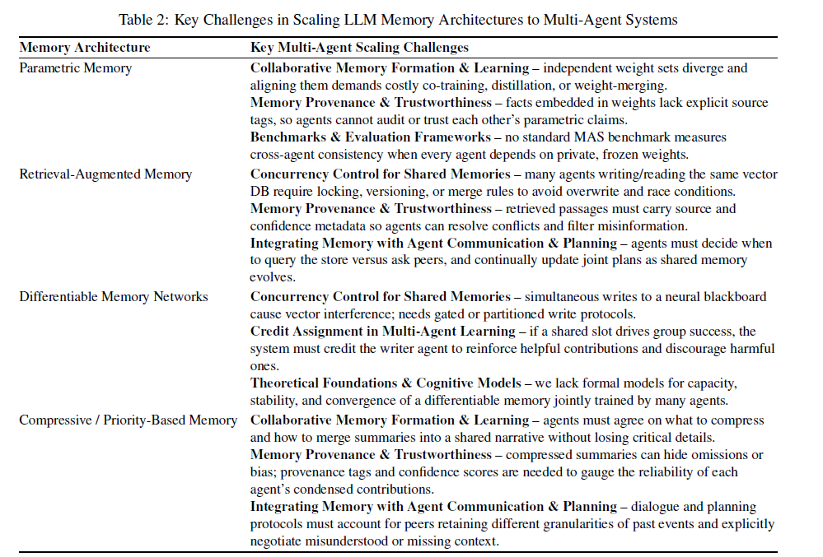
Literature Gap cont.
Four pressing gaps uncovered by the review:
Memory Provenance.
Concurrency in Shared Memory.
Auditability; and,
Data Integrity.
Mindful of the project’s scope, we focused on Memory Provenance and Data Integrity.

Slide 5
Why Blockchain Technology?
Blockchain technology is a natural fit for the two selected research gaps (Crosby et a;. 2016):
  Cryptographic signatures → verifiable provenance
  Append-only ledger → immutable history (data integrity)

Slide 6
Research Aim & Core Question
Research Aim:
The aim of this project was to determine the feasibility of using a blockchain for trustworthy AI agent memory. This was achieved by designing a proof-of-concept architecture and then rigorously testing its performance, cost, and scalability under different data loads.
Research Question:
A blockchain-based system is a feasible way to create a trustworthy, shared memory for AI agents, where they can verify the source and integrity of information.

Slide 7
Methodology & Key Metrics
Study Design: Design -> Simulate -> Analyse (Hevner et al., 2004)
Key Metrics:
  Provenance Verification Accuracy (PVA)
  Transaction Throughput (TT)
  Verification Latency (VL)
  Average Gas Cost
Tamper simulation omitted from this project.
Table 3: Key Metrics
Metric | Definition Example | Measurement Method
Provenance Verification Accuracy (PVA) | 1.0 or 100% | Measures system relaibility. Total number of legitimate entries that passed their cryptographic signature verification, divided by the total number of legitimate entries that were submitted. A score of 1.0, or 100%, indicates that the verification process was perfectly reliable for that run.
Transaction Throughput (TT) | 5/s | Measures on-chain write speed. Total time in seconds from the start of the first transaction submission to the confirmation of the last. The TT is then calculated as the total number of successfully confirmed transactions divided by this total time.
Verification Latency (VL) | 3.2 ms | Measures off-chain trust speed. During the verification phase of each run,the time tkaen is recorded for every single signature check in milliseconds. The VL for that run is the statistical average (mean) of all these individual time measurements. A lower VL indicates that agents can verify and trust data more quickly.
Average Gas Cost (AvgGas) | 41,400 | Assesses the economic viability. Every time a transaction is successfully confirmed, the blockchain returns a receipt containing the exact amount of computational work, or 'gas,' that was used. This gasUsed value was collected for every transaction in a run. The final metric is the average of all those individual gas values, giving a stable measure of the computational cost to store a single memory entry.

Slide 8
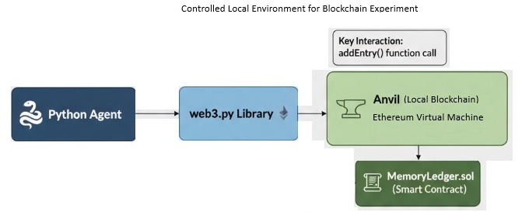
Methodology – Simulation Design
GitHub: https://github.com/jimy-r/RM8502---Research-Project-
Figure 1: Simulation Design
Table 4: System Components
Layer | Choice | Rationale
Agent Runtime | Python asyncio | Lightweight, good for I/O (interacting with ledger), easy wallet ops via Web3.py.
LLM Backbone | Stubbed / Minimal | Core focus is on ledger architecture & trust, not complex agent reasoning. LLM integration was out of scope for this project.
Ledger | Anvil fork of OP Stack (private devnet) | Full EVM control for design/simulation; allowed easy deployment/testing of smart contracts.
Smart Contracts | Solidity 0.8.x (if contract-based state management is chosen for entries) | Standard for EVM; used to define on-chain protocol logic for addSignedEntry, verifyEntrySignature.
Cryptography | Standard libraries (e.g., Python's hashlib, ecdsa via web3.py) | For signing/verifying agent transactions/entries. Required for provenance.

Slide 9
Methodology – Experimental Design
Test Parameters:
  Independent Simulation Runs (T) = 10 Runs
  Number of Transactions per Run (N) = 50 Transactions
Final Parameters:
  Independent Simulation Runs (T) = 30 Runs
  Number of Transactions per Run (N) = 500 Transactions
Independent Variable: Payload Size
  Small: A short fact about the environment (90 bytes)
  Medium: A specific observation or detail of an agent’s current state (190 bytes)
  Large: A complex event sequence or detail with significant context (350 bytes)
Total Workload: 45,000 Transactions
Ethical approvals were not required.

Slide 10
Methodology – Data Collection & Analysis
Automated Analysis: Simulation script was designed to perform a complete, automated analysis immediately following the data collection phase
Quantitative Outputs: Descriptive statistics (mean, std), 95% confidence intervals, and hypothesis test results printed directly to the console for real-time monitoring and captured in a final experimental log.
Visual Outputs: Per-payload boxplots, latency histograms, and the final comparative plots outputted to command line.

Slide 11
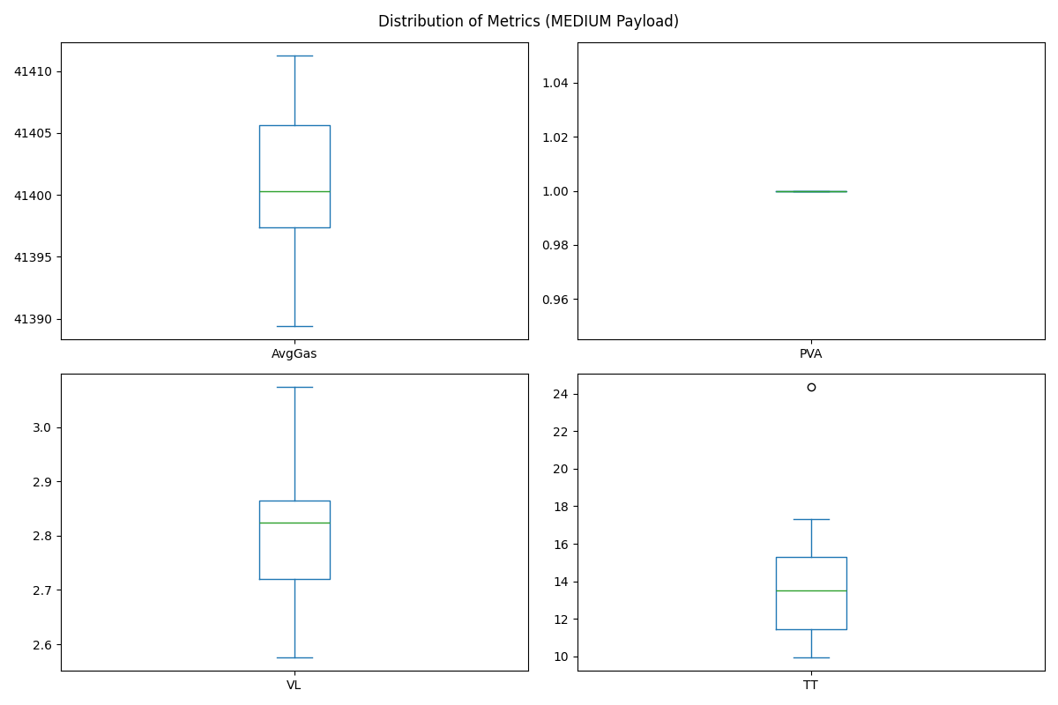
Results - Flawless Provenance
Provenance Verification Accuracy (PVA): 100% Accuracy
Figure 2: Distribution of Metrics (Medium Payload)

Slide 12
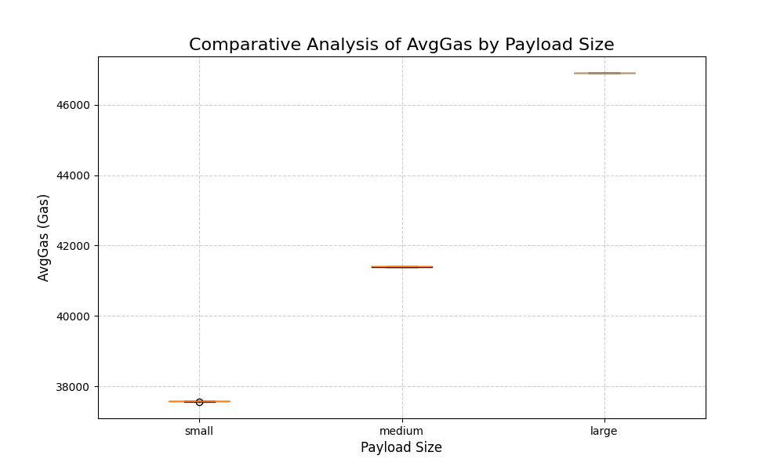
Results - Predictable Cost
Gas cost scaled linearly with the size of the data.
Figure 3: Comparative Analysis of Avg Gas by Payload Size

Slide 13
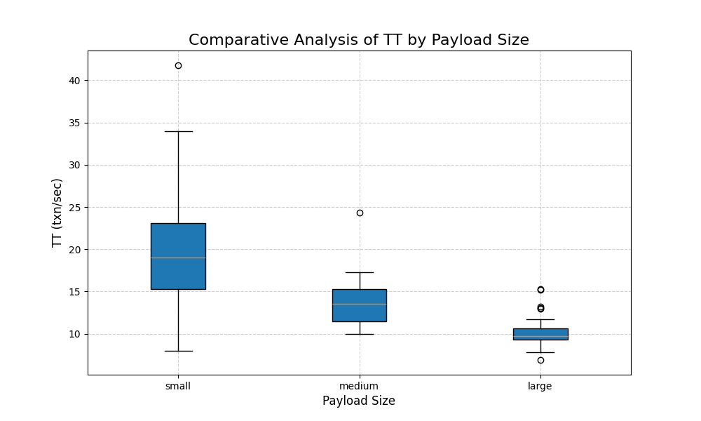
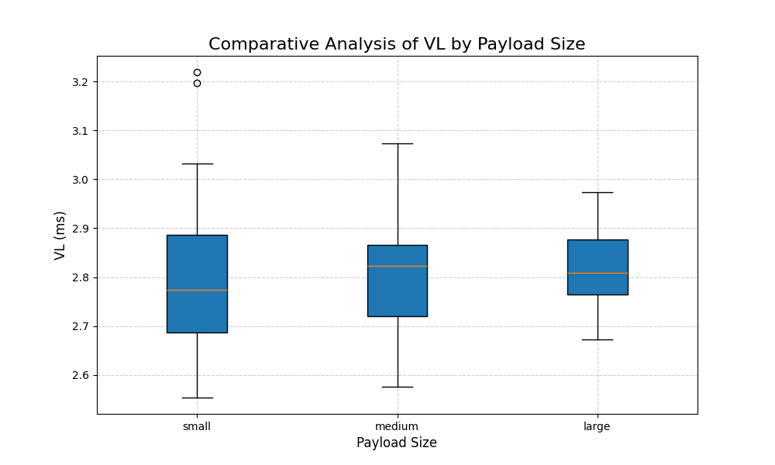
Results - Performance Trade-off
Transaction Throughput (TT): Decreasing throughput with larger payload size (avg. only 10-20 transactions per second).
Verification latency (VL): Extremely Fast & Scalable (~2.8 ms)
Figure 4: Comparative Analysis of TT by Payload Size
Figure 5: Comparative Analysis of VL by Payload Size

Slide 14
Discussion
Flawless Provenance:
  Cryptographic architecture is reliable in the controlled environment (‘best-case’).
  Architecture proves who said what, no guarantee that what was said is true.
Predictable Cost:
  Gas cost increased proportionally with the size of the data being stored.
  Deterministic cost-benefit analysis.
  Gas market does fluctuate on a live network.
Performance Trade-off
  Clear on-chain bottleneck (10 – 20 transactions per second).
  Off-chain efficiency was excellent (under 3 milliseconds).
  Slow to write but fast to trust.

Slide 15
Discussion cont.
Limitations:
  Local testnet environment
  Simple agent & dummy data
  Focus on ‘Happy Path’: Did not test against adversarial attacks
Future:
  Deploy on both active Ethereum testnet and Layer 2 testnet like Arbitrum (Kalodner et al. 2018) to compare real world speed and cost
  Utilise LLM agents that are performing a collaborative task
  Implement Adversarial Testing: Design malicious agents to quantitatively measure the system’s resilience.

Slide 16
Conclusion
Architecture sacrifices on-chain write speed for perfect, near-instantaneous off-chain trust.
System highly feasible for high value, low frequency data applications.

Slide 17
References
Crosby, M., Pattanayak, P., Verma, S., & Kalyanaraman, V. (2016). Blockchain technology: Beyond Bitcoin. Applied Innovation Review, (2), 6–19.
Gao, Y., Xiong, Y., Gao, X., Jia, K., Pan, J., Bi, Y., Dai, Y., Sun, J., Wang, M., & Wang, H. (2024). Retrieval-augmented generation for large language models: A survey. https://arxiv.org/abs/2312.10997
Guo, T., Chen, X., Wang, Y., Chang, R., Pei, S., Chawla, N. V., Wiest, O., & Zhang, X. (2024). Large language model based multi-agents: A survey of progress and challenges. https://arxiv.org/abs/2402.01680
Hevner, A. R., March, S. T., Park, J., & Ram, S. (2004). Design science in information systems research. MIS Quarterly, 28(1), 75–105.
Kalodner, H., Goldfeder, S., Chen, X., Weinberg, S. M., & Felten, E. W. (2018). Arbitrum: Scalable, private smart contracts. In 27th USENIX Security Symposium (USENIX Security 18) (pp. 1353–1370). USENIX Association.
Khosla, S., Zhu, Z., & He, Y. (2023). Survey on memory-augmented neural networks: Cognitive insights to ai applications. https://arxiv.org/abs/2312.06141
Manzoor, M. A., Albarri, S., Xian, Z., Meng, Z., Nakov, P., & Liang, S. (2023). Multimodality representation learning: A survey on evolution, pretraining and its applications. ACM Trans. Multimedia Comput. Commun. Appl., 20(3). https://doi.org/10.1145/3617833
Wang, L., Zhang, X., Su, H., & Zhu, J. (2024). A comprehensive survey of continual learning: Theory, method and application. IEEE Transactions on Pattern Analysis and Machine Intelligence, 46(8), 5362–5383. https://doi.org/10.1109/TPAMI.2024.3367329

Slide 18
References cont.
Wang, S., Zhu, Y., Liu, H., Zheng, Z., Chen, C., & Li, J. (2024). Knowledge editing for large language models: A survey. ACM Comput. Surv., 57(3). https://doi.org/10.1145/3698590
Wiesinger, J., Marlow, P., & Vuskovic, V. (2024, November). Agents (White paper) (Retrieved from the Internet Archive). Google. Retrieved May 4, 2025, from https://archive.org/details/google-ai-agents-whitepaper
Yu, M., Meng, F., Zhou, X.,Wang, S., Mao, J., Pang, L., Chen, T.,Wang, K., Li, X., Zhang, Y., An, B., &Wen, Q. (2025). A survey on trustworthy llm agents: Threats and countermeasures. https://arxiv.org/abs/2503.09648
Zhang, Z., Bo, X., Ma, C., Li, R., Chen, X., Dai, Q., Zhu, J., Dong, Z., & Wen, J.-R. (2024). A survey on the memory mechanism of large language model based agents. https://arxiv.org/abs/2404.13501

Slide 19
Appendix A – Data Summary
Figure 6: Final Test Data Summary by Payload Size
Metrics | Small Payload | Medium Payload | Large Payload
AvgGas | 37578.246 | 41400.99133 | 46905.362
PVA | 1 | 1 | 1
VL | 2.802704954 | 2.805641508 | 2.814731455
TT | 20.10073784 | 13.72952111 | 10.24514462

Slide 20
Appendix C – Abstract
Autonomous agents often lack trustworthy shared memory, which limits effective collaboration. This research project proposes a blockchain-inspired decentralised ledger to address this gap, focusing on a design that uses cryptographic signatures to ensure verifiable provenance. Rather than only focusing on theoretical design, this work provides a quantitative proof-of-concept by experimentally measuring the architecture's feasibility. This was achieved by evaluating its core performance characteristics; transaction throughput and verification latency along with its economic cost and scalability under different data loads. The findings establish a critical performance baseline and detail the fundamental trade-off between on-chain write speed and off-chain trust. This foundational work provides a clear, data-driven framework for understanding the practical application and limitations of DLTs in enhancing collaborative AI.

Slide 21
Thank you for listening.
Questions?

